Slide 1

Predicting Flight Ticket Prices
Regression Project Presentation | Machine Learning CA1
Eduardo J. Matos Romero
20 November 2023

Slide 2


Goal
To build a reliable machine learning model capable of accurately predicting flight ticket prices.
Steps to achieve it
Exploratory Data Analysis of features.
Modelling testing
Hyperparameter Tuning
Modelling

Slide 3
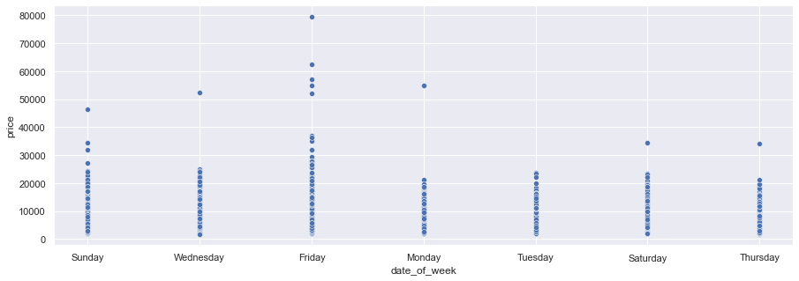
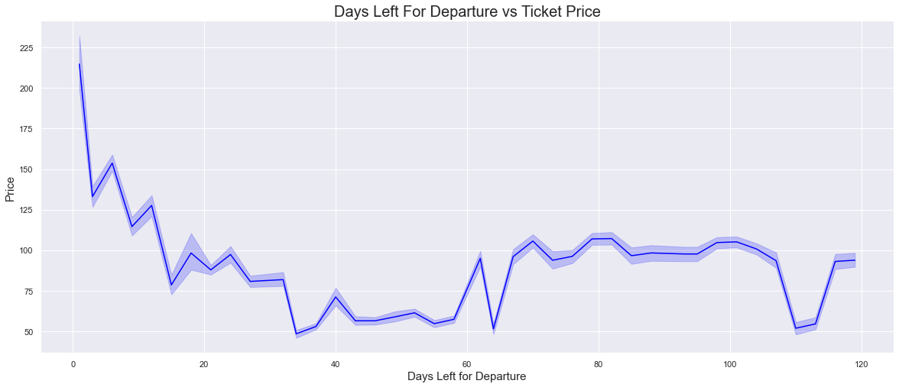
Exploratory Data Analysis
Tickets prices are in general:
More expensive if you fly on a Friday.
Cheaper if you fly on Monday.
Tickets prices are in general:
More expensive if booked on the same day.
Cheaper if booked more than 30 days in advance.

Slide 4
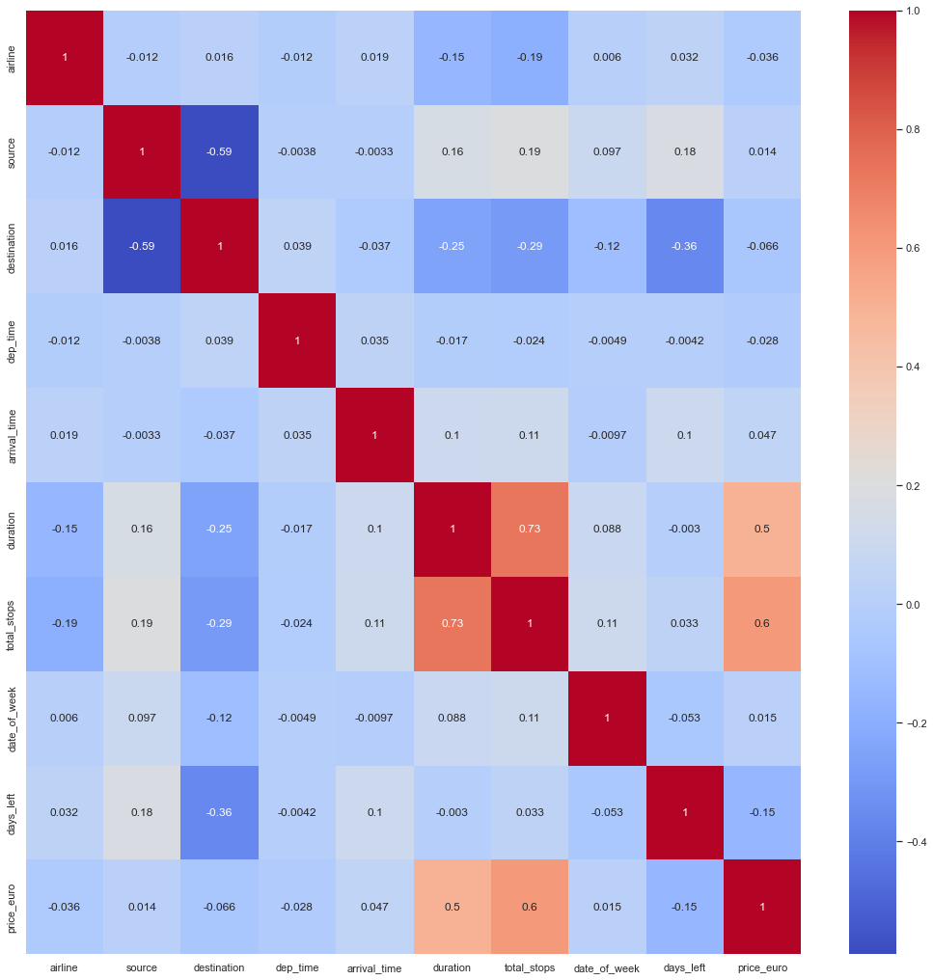
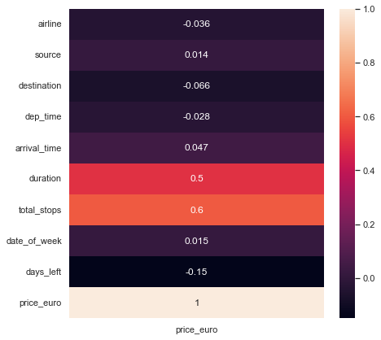
Exploratory Data Analysis
Features

Slide 5
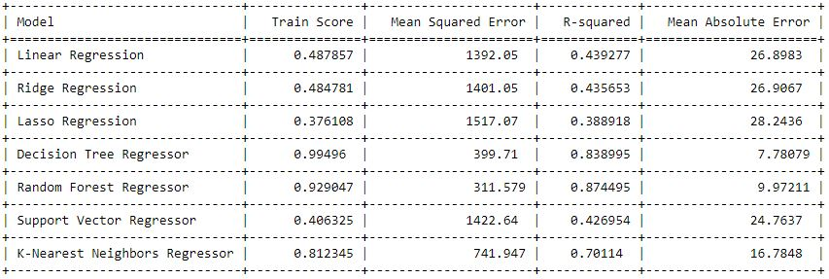
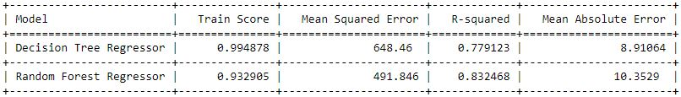
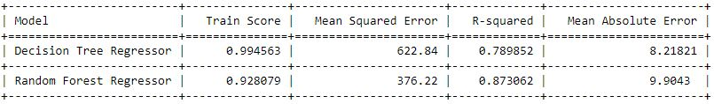
Modelling Testing
80 - 20%
70 - 30%
90 - 10%
Best performance
Random forest
Decision tree
Splitting 70-30%

Slide 6
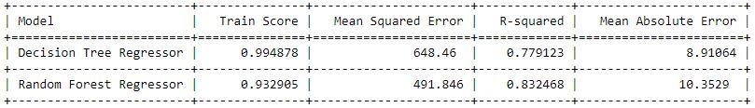

Hyperparameter Tuning - Modelling
Before
Increasing in the training R-squared
Improved model fit.
Decreasing in MSE
Better model's predictions.
Decreasing in R-squared
Minor reduction in generalization performance.
After
Decreasing in MAE
Improved accuracy.

Slide 7
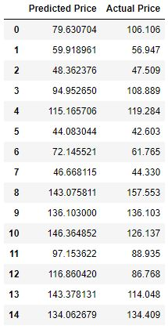

Results
Mean error
9.05 €

